Slide 1
VAIGAI COLLEGE OF ENGINEERING,
MADURAI – 600 025
DEPARTMENT OF COMPUTER SCIENCE AND ENGINEERING
BOOSTING-BASED DDOS DETECTION IN INTERNET OF THINGS SYSTEM
USING MACHINE LEARNING
Presented By :
GOWTHAM S (913320104017)
KARTHIK S (913320104301) VIGNESH M (913320104304)

Slide 2
ABSTRACT
To classify or predict the DDOS attack.
To identify or detecting the attacks which in occurred in the network by using the various classification algorithms.
To implement the different machine and deep learning algorithms.
To enhance the overall performance for classification algorithms.

Slide 3
INTRODUCTION
Internet of Things (IoT) devices and systems are becoming common place, and hence they are increasingly targeted by attackers, for example, by identifying and exploiting vulnerabilities in IoT software and hardware, or their implementation, to facilitate unauthorized and malicious activities.
There have been many applications of machine learning techniques to detect DDoS traffic, which can be categorized into those based on supervised techniques.
As with any machine learning model development, the goal is to use those independent features whose change has the greatest impact on changing the dependent feature.

Slide 4
EXISTING SYSTEM
In existing, Distributed denial of service (DDoS) attacks remain challenging to mitigate in existing systems, including in-home networks that comprise different Internet of Things (IoT) devices.
In this paper, we present a DDoS traffic detection model that uses a boosting method of logistic model trees for different IoT device classes.
Different model versions are generated for each device class due to subtle variations in network traffic characteristics. For instance, in a smart home, devices can be categorized into four classes for analysis.
Our evaluations indicate accuracy rates of 99.92% to 99.99% for the four device classes, showcasing their effectiveness in detecting DDoS traffic.

Slide 5
PROPOSED SYSTEM
In this system, UNWS dataset was taken as input from the dataset repository like UCI repository.
We have to implement the data pre-processing step. In this step, we have to handle the missing values for avoid wrong prediction, to encode the label for input data and drop the unwanted columns from our input data.
Then, we have to implement the different classification algorithms both machine and deep learning algorithms for detecting the DDOS attack.
The machine learning classification algorithms such as MLP, KNN, random forest and ada-boost algorithms.
The experimental results shows that the performance metrics such as accuracy , precision, recall and f1-score.

Slide 6
SYSTEM REQUIREMENTS
Hardware Requirements
System : Pentium IV 2.4 GHz
Hard Disk : 200 GB
Mouse : Logitech.
Keyboard : 110 keys enhanced
Ram : 4GB

Slide 7
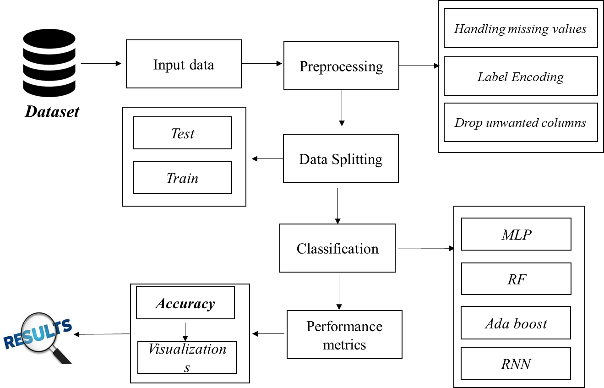
FLOW DIAGRAM

Slide 8
MODULES
Module I - Data selection
Module II - Data preprocessing
Module III - Classification

Slide 9
DATA SELECTION
The input data was collected from dataset repository.
In our process, the UNWS dataset is used.
The data selection is the process of detecting the malicious traffic.
The dataset includes on the Internet of Things, and normal traffic flows as well as several numerous cyber-attacks traffic flows of botnets attacks.
However, for better performance results, the extracted features are labelled, such as attack flow, categories, and subcategories.

Slide 10
DATA PRE-PROCESSING
Data pre-processing is the process of removing the unwanted data from the dataset.
Pre-processing data transformation operations are used to transform the dataset into a structure suitable for machine learning.
Missing data removal: In this process, the null values such as missing values and NaN (Not a Number) values are replaced by 0.
Encoding Categorical data: That categorical data is defined as variables with a finite set of label values.

Slide 11
CLASSIFICATION
In our process, we have to implement the machine and deep learning algorithms such as MLP, KNN, RF, Ada boost and RNN respectively.
An MLP is a type of feedforward ANN. It can refer broadly to any such network or specifically to those with multiple layers of perceptions.
Random forest is a classification algorithm comprising multiple decision trees. It employs bagging and feature randomness in tree construction to create an uncorrelated forest for more accurate predictions.
Ada-boost or Adaptive Boosting is one of ensemble boosting classifier. It combines multiple classifiers to increase the accuracy of classifiers. AdaBoost is an iterative ensemble method

Slide 12
PERFORMANCE ANALYSIS
The Final Result will get generated based on the overall classification and prediction. The performance of this proposed approach is evaluated using some measures like,
Accuracy
Precision
Recall
F1-score
Comparison graph for all algorithms based on accuracy.

Slide 13
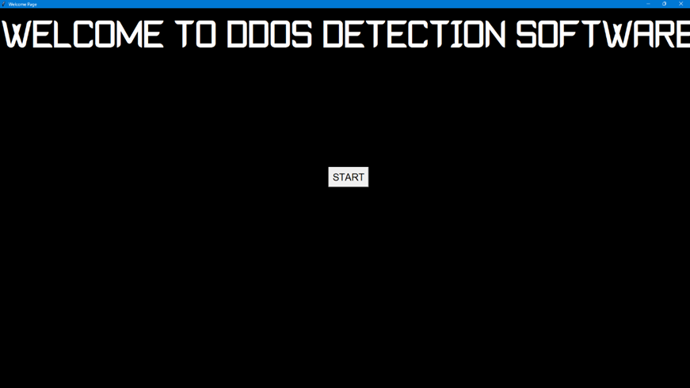
OUTPUT

Slide 14
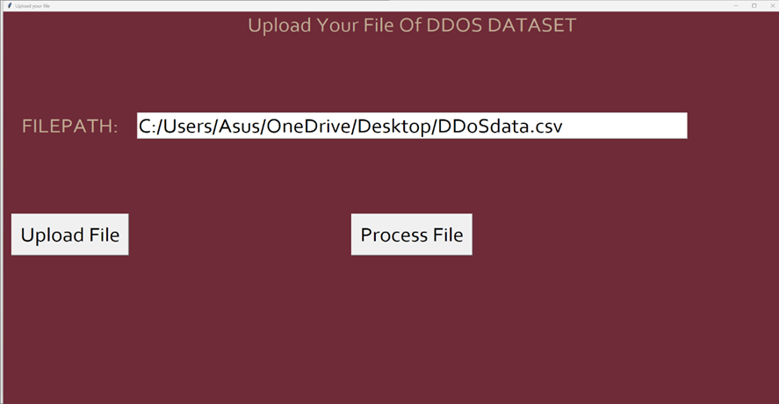
OUTPUT
MLP

Slide 15
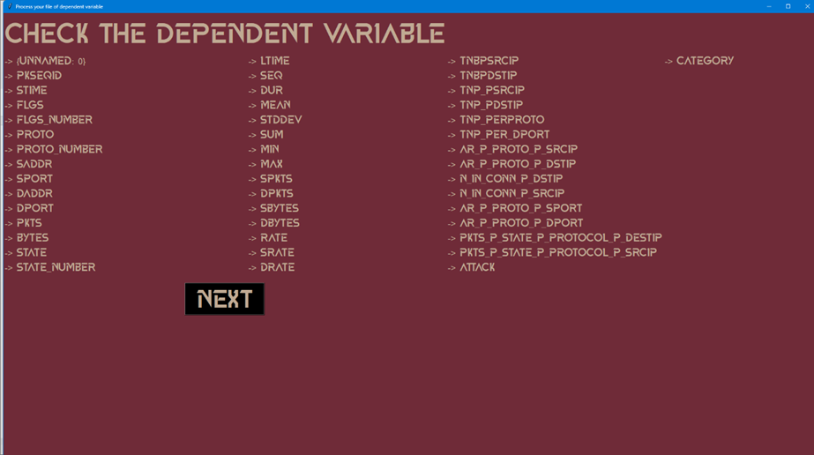
OUTPUT
MLP

Slide 16
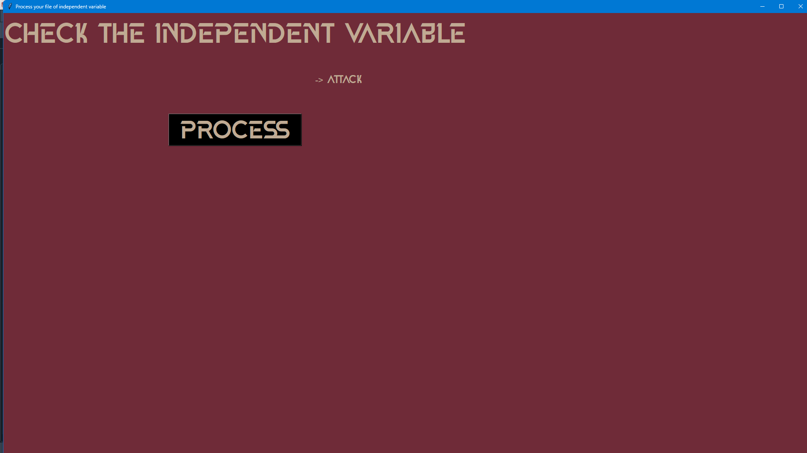
OUTPUT
MLP

Slide 17
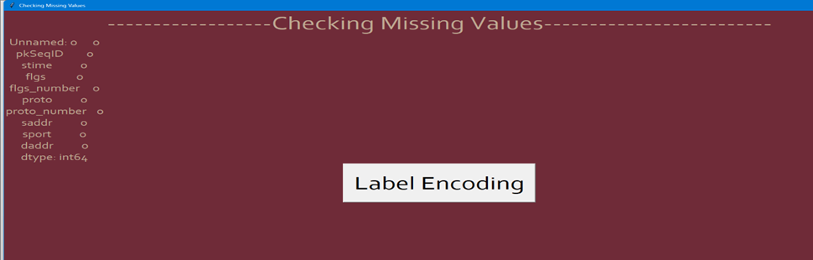
OUTPUT

Slide 18
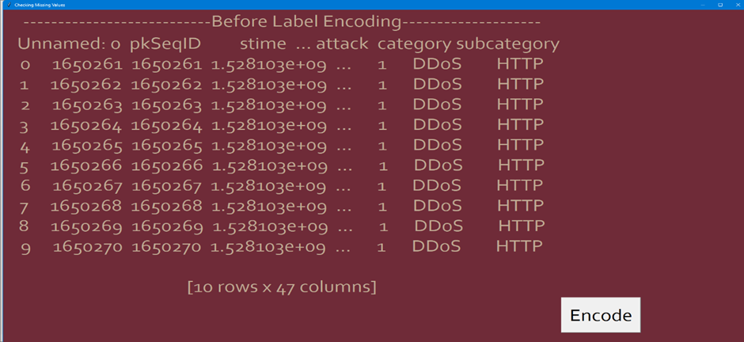
OUTPUT

Slide 19
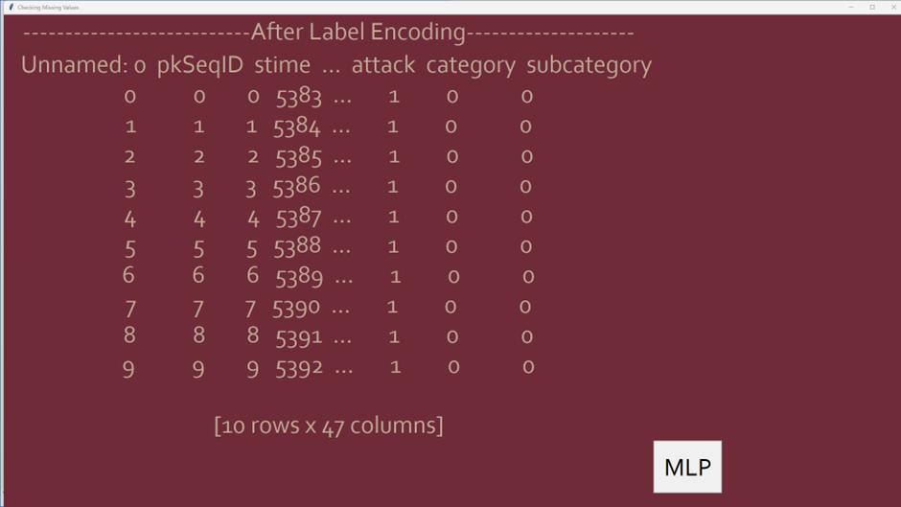
OUTPUT

Slide 20
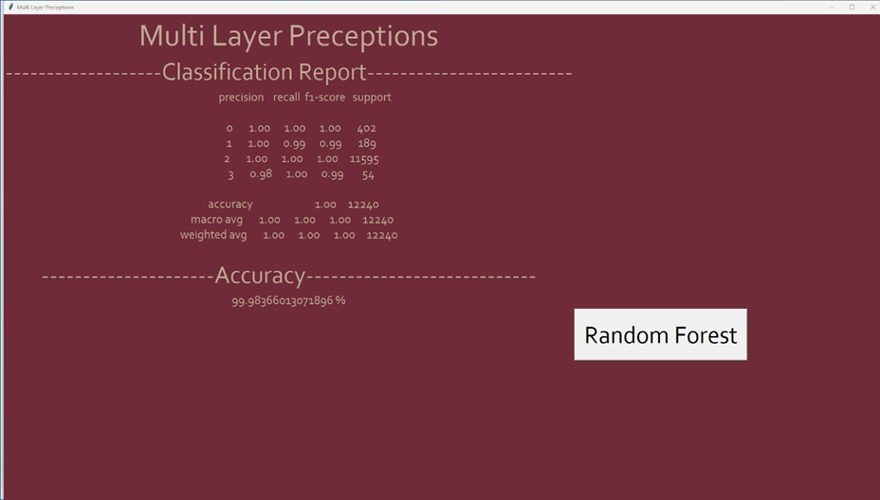
OUTPUT
MLP

Slide 21
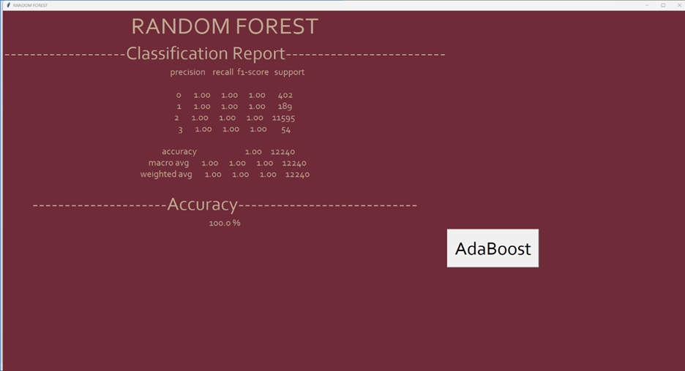
OUTPUT
RANDOM FOREST

Slide 22
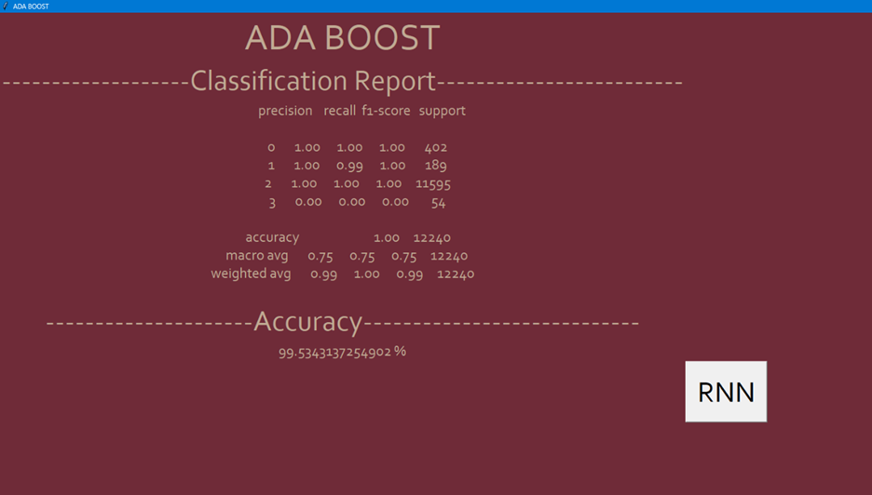
OUTPUT
ADABOOST

Slide 23
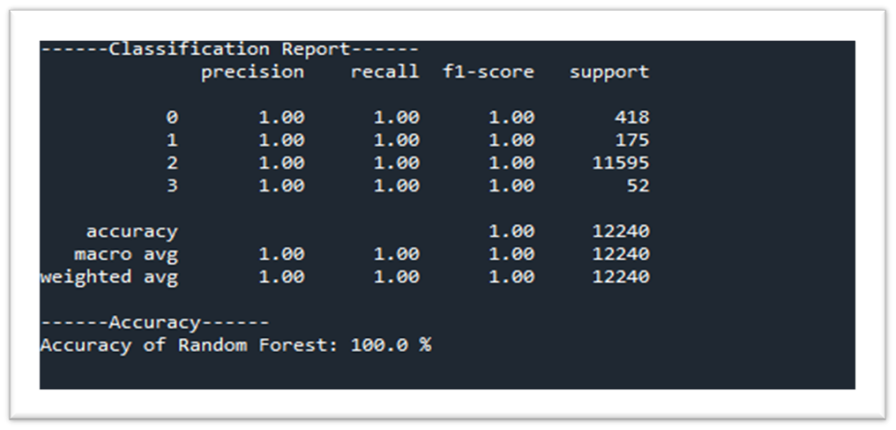
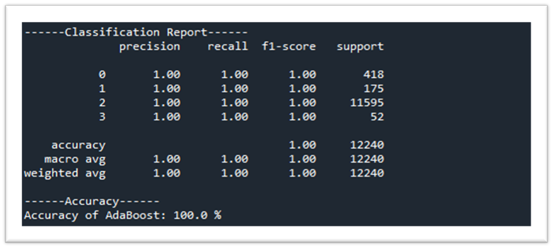
OUTPUT
RANDOM FOREST
AdaBoost

Slide 24
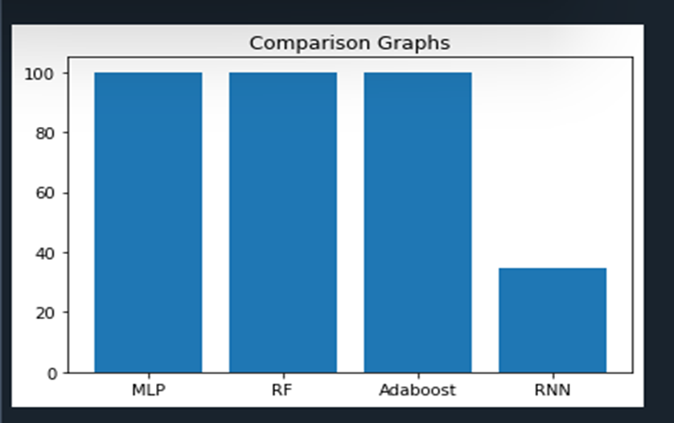
PERFORM ANALYSIS

Slide 25
FUTURE ENHANCEMENT
In the future, we should like to hybrid the two different machine learning or to hybrid two deep learning algorithms as a multi-layered model to improve the detection performance.
The dataset analyzed in this study was from a single network. This study can be conducted with a larger and smaller network area.
In near future systems are moving towards Analytics and Data network to find the Prediction through machine learning or deep learning.

Slide 26
REFERENCES
[1] S. Chavhan, D. Gupta, B. Chandana, A. Khanna, and J. J. Rodrigues, “Iot-based context-aware intelligent public transport system in a metropolitan area,” IEEE Internet of Things Journal, 2021.
[2] L. Chettri and R. Bera, “A comprehensive survey on internet of things (iot) towards 5g wireless systems,” IEEE Internet of Things Journal, vol. 7, no. 1, pp. 16–32, 2020.
[3] Z. Wang, Y. Liu, Z. Ma, X. Liu, and J. Ma, “Lipsg: Lightweight privacypreserving q-learning based energy management for the iot-enable smart grid,” IEEE Internet of Things Journal, vol. 7, no. 5, pp. 3935–3947, 2020.
[4] J. Qiu, Z. Tian, C. Du, Q. Zuo, S. Su, and B. Fang, “A survey on access control in the age of internet of things,” IEEE Internet of Things Journal, 2020.
[5] K. Lab. (2019) Amount of malware targeting smart devices more than doubled in. [Online].

Slide 27
THANK YOU

